Slide 1
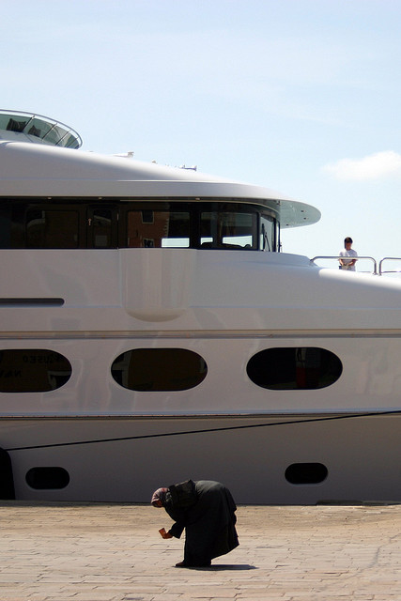
Core: Unit 2
Disparities in wealth and development

Slide 2
Disparities in wealth and development
1. Measurements of regional and global disparities
2. Origins of Disparities
3. Disparities and Change
4. Reducing Disparities

Slide 3
1. Measurements of regional and global disparities
Define indices of infant mortality, education, nutrition, income, marginalisation and Human Development Index (HDI).
Explain the value of the indices in measuring disparities across the globe.

Slide 4
Aim:
To identify different development indicators and
evaluate their value as well as examine the
current global situation

Slide 5
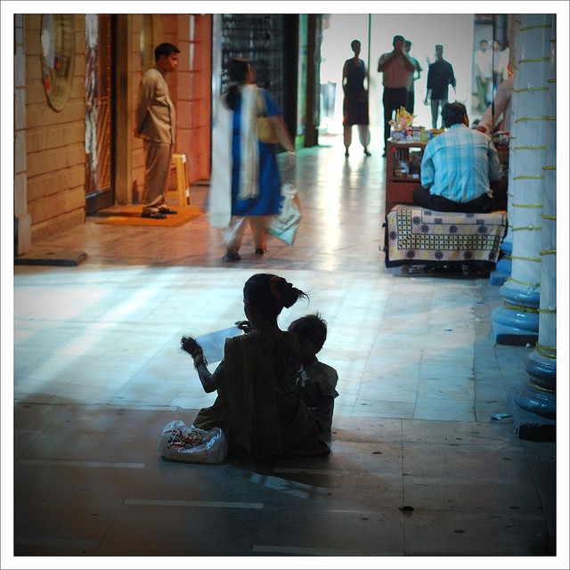
What is Development?
Come up with your own definition…

Slide 6
Development: Economic development is typically measured in terms of jobs and income, but it also includes improvements in human development, education, health, choice, and environmental sustainability.
Equity: the concept of idea of fairness or justice.
Social justice: the belief that every individual and group is entitled to fair and equal rights and participation in social, educational, and economic opportunities.
Marginalisation: relegate to a lower or outer edge, as of specific groups of people.
Interdependence: the mutual responsibility and dependency on others.

Slide 7

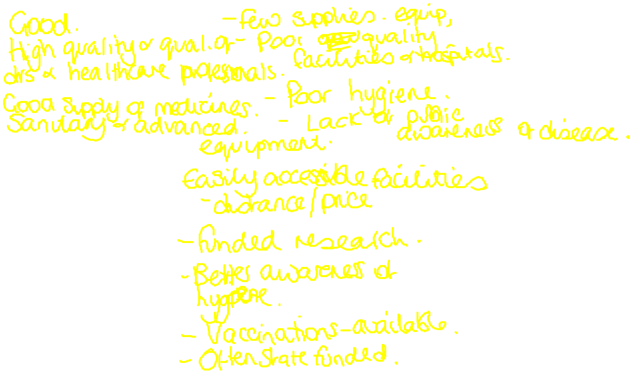
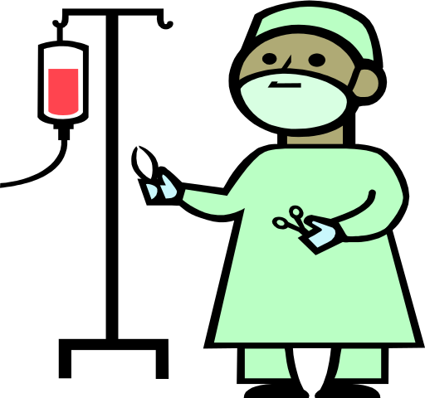

Characteristic
What would you expect to see in an HIC?
What would you expect to see in an LIC?
Reasons for the differences between HICs & LICs
Medical care
What numerical data could we use to prove whether a country was an HIC or LIC?

Slide 8

Identify
What data could help us to determine / judge development?
Explain
Now complete the definitions for single index measurements

Slide 9
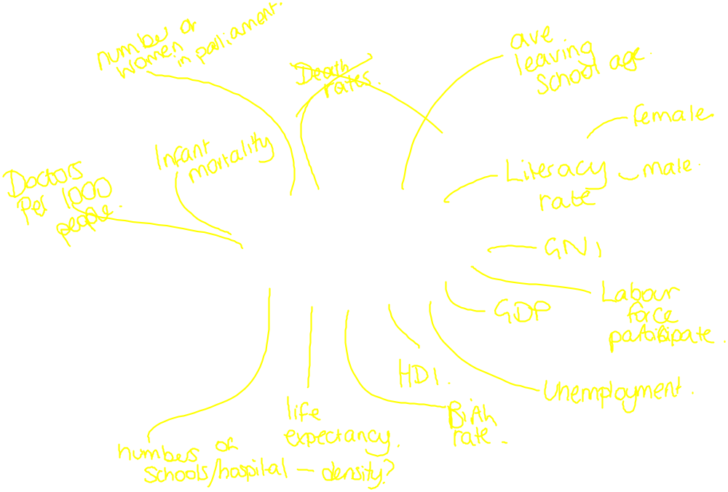
Identify
What data could help us to determine / judge development?
Explain
Now complete the definitions for single index measurements

Slide 10
QUALITATIVE INDICATORS
Describe development rather than measure .
e.g. Security, survival
Useful?
Economic growth
Interdependency
Demographics
Life Expectancy
Mobility
Personal Wealth
Quality of Life
Social Justice
Equal Opportunities
Satisfaction
Cultural
Education
Identity
Culture
Freedom of Speech
Democratic Government
Conservation
Sustainability
Environmental Change
COMPOSITE INDICATORS
Combine several other factors in one single figure
E.g. HDI
Useful?
QUANTITATIVE INDICATORS
Numbers rather than descriptions
GDP per Capita
Useful?

Slide 11
What are the strengths and weaknesses of each?
Infant mortality
Literacy rate
Education expenditure
Malnutrition
Income

Slide 12
Use the map and table to collect recent data for an index of infant mortality or education or nutrition or income.
Use the data from http://data.worldbank.org/indicator to produce a choropleth map.
Brainstorm the value of the indices in measuring disparities across the globe - are some better than others, how difficult are the data sets to collect?

Slide 13

http://www.youtube.com/watch?v=xIbkPPkuKno&feature=player_embedded

Slide 14
HDI ranks
Which countries will be the top 3?
Which countries will be the bottom 3?

Slide 15
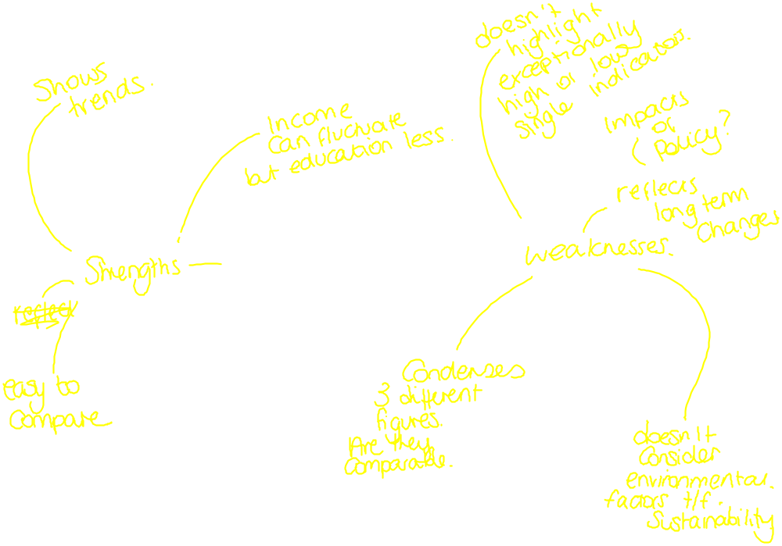
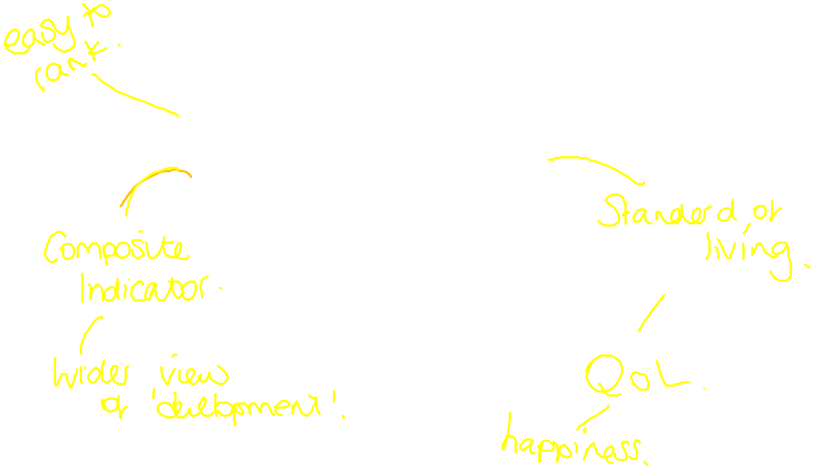
What are the strengths and weaknesses of HDI to measure development?

Slide 16
Choose 6 countries
These must include some that we have looked at so far in the core
You could choose; China, Brazil, DR Congo, Indonesia, Kenya, Norway, USA
Identify their HDI ranking
Explain why they are where they are
Suggest ways in which they could improve their ranking.
Describe the trends in their HDI over time

Slide 17
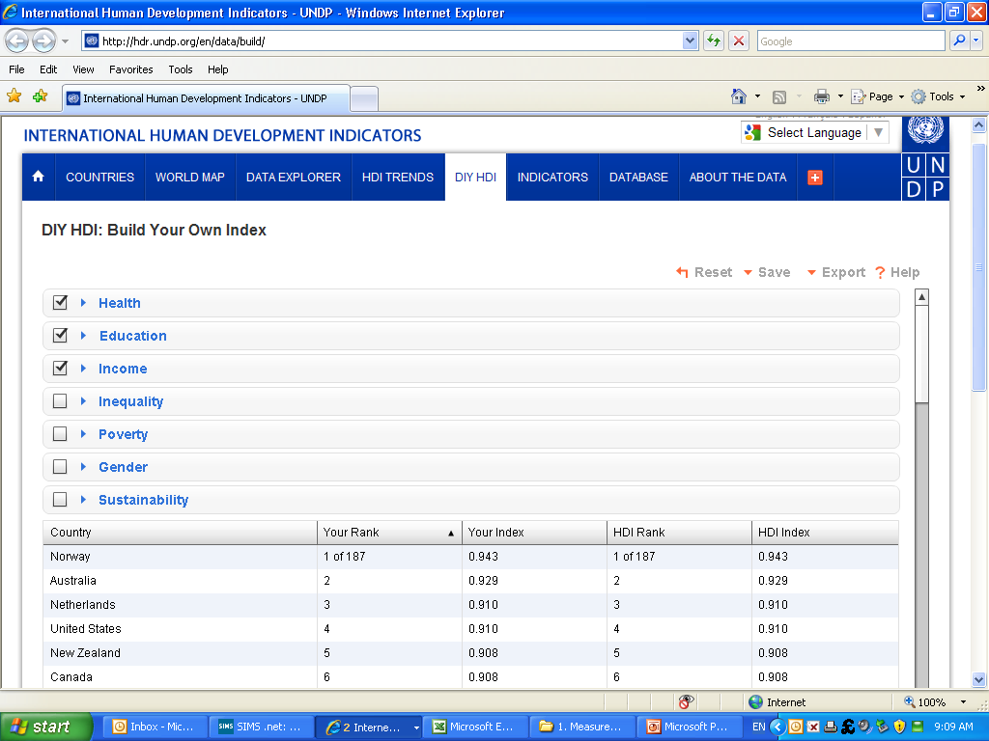
http://hdr.undp.org/en/data/build/

Slide 18

What’s so good about being developed?
Where in the world would you be happiest?

Slide 19

Qualitative measures of development….
http://www.youtube.com/watch?v=7Zqdqa4YNvI&feature=related

Slide 20
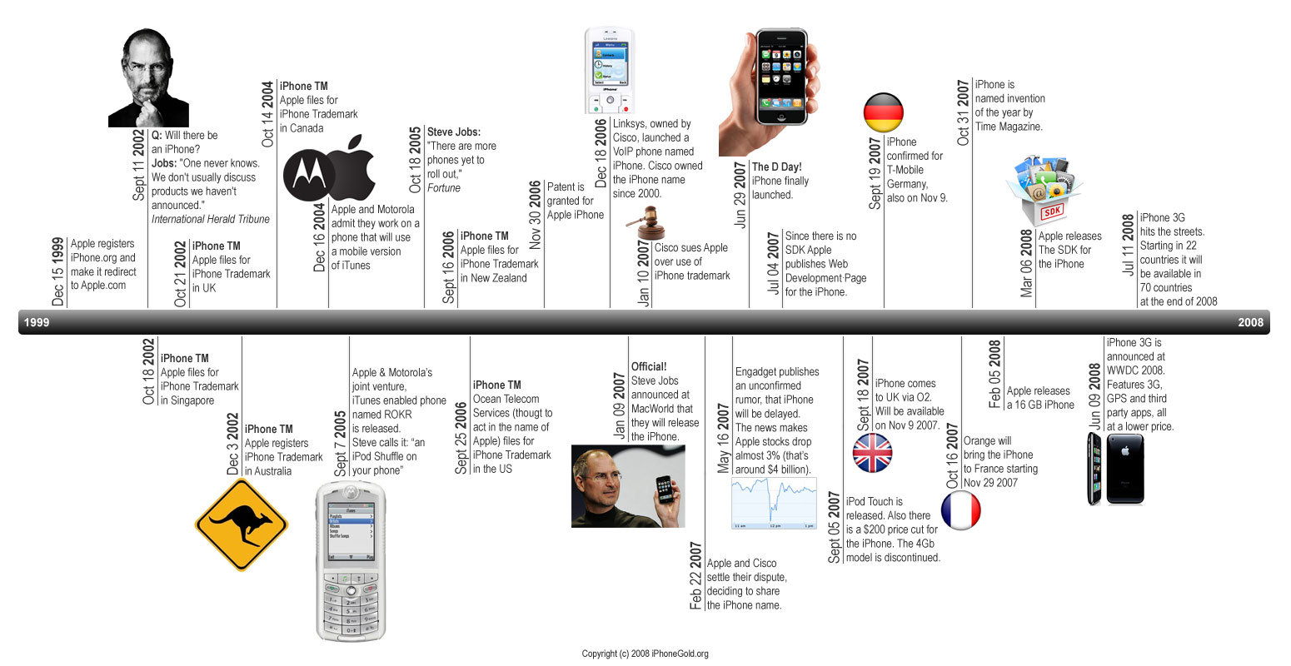
Putting countries into boxes…

